Slide 1
Crop Production Analysis in India
By- Savio
Rebello

Slide 2
Objective
The objective of this project is to leverage advancements in the Future Internet to develop a novel Business-to-Business collaboration platform within the agri-food sector. This platform aims to enhance collaboration among stakeholders across various business domains in the agriculture supply chain. By harnessing a vast dataset on crop production in India spanning multiple years, the goal is to utilize predictive analytics to forecast crop production accurately. Additionally, the project seeks to uncover significant insights by identifying key indicators and metrics that influence crop production trends.

Slide 3
Problem Statement
The Agriculture business domain, as a vital part of the overall supply chain, is expected to highly evolve in the upcoming years via the developments, which are taking place on the side of the Future Internet. This paper presents a novel Business-to-Business collaboration platform from the agri-food sector perspective, which aims to facilitate the collaboration of numerous stakeholders belonging to associated business domains, in an effective and flexible manner. This dataset provides a huge amount of information on crop production in India ranging from several years. Based on the Information the ultimate goal would be to predict crop production and find important insights highlighting key indicators and metrics that influence crop production. Make views and dashboards first and also make a story out of it

Slide 4



Key Insights

Slide 5
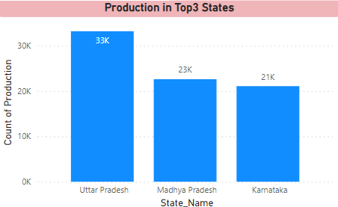
Crop Production by top 3 states

Slide 6
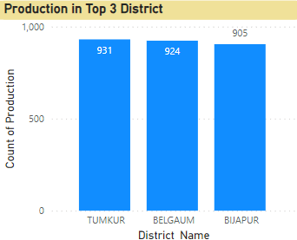
Crop Production by top 3 district

Slide 7
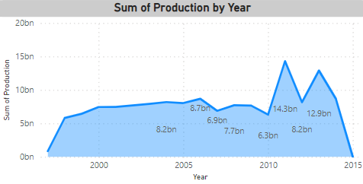
Production Trends by Year

Slide 8
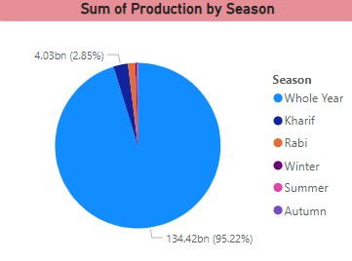
Total Production by Season

Slide 9
Conclusion
In top 3 production state Uttar Pradesh is the highest crop production state with 33k
In top 3 production district Tumkur has the highest crop production
In crop production by year 2011 has the highest with 14.3 bn
In the pie chart 95% of crop production is done whole year with 134.42 bn

